Slide 1
Lead Scoring Case Study
By-Monica Fatwani & Rohit Lal

Slide 2
Problem Statement
X Education is an online education providing company. The leads that the company acquires are through various marketing platforms as well as inbounds from company websites. The current conversion rate is 30% for the leads that are getting generated. To increase the rate of conversion, the company wants to identify the “Hot Leads” so that the rate of conversion can be increased. A model needs to be built wherein lead scores are assigned to each of the leads. Higher lead scores should correspond to high chances of conversion and lower lead scores to low chances.

Slide 3
Approach
Loading and Inspecting data
Data Cleaning
EDA
Data Preparation for Modeling
Model Building
Confusion Matrix
ROC Curve
Assigning Lead Score
Make Predictions on Test dataset

Slide 4
Loading , Data Cleaning & EDA
Load Leads.csv and read and inspect data set.
While Data Cleaning, we will Replace the 'Select' column with NaN values, since it signifies missing data (i.e, no option is selected)
Drop single-valued columns, since they won't contribute to our analysis.
Drop columns with high percentage of missing values(> 45%)
Drop categorical columns that are highly skewed impute columns with less number of missing values.
In EDA, we will perform Univariate Analysis for all the columns in data set.
After univariate analysis we have seen that many columns are not adding any information to the model which includes 'Lead Number', 'A free copy of Mastering The Interview', 'Country', 'Tags', hence we drop them for further analysis.

Slide 5
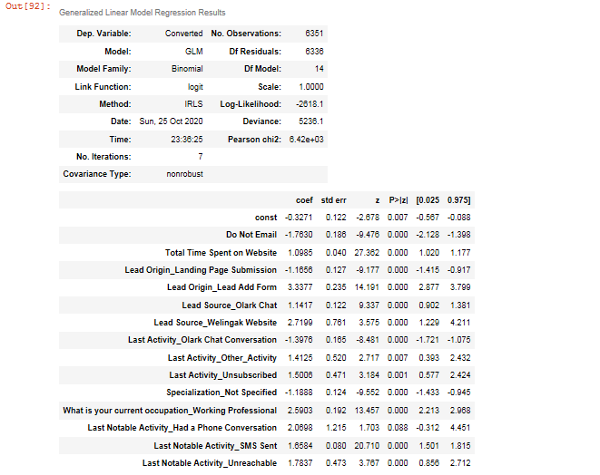
Data Modeling
Before Data Modeling, we will prepare data for modeling by converting some binary variables (Yes/No) to 1/0.
For categorical variables with multiple levels, create dummy features.
Split the data in Train and Test split and then scale the data.
Here we will use RFE for eliminating variables and then manually reduce the variables by creating GLM Regression. Below is our final GLM Results.

Slide 6
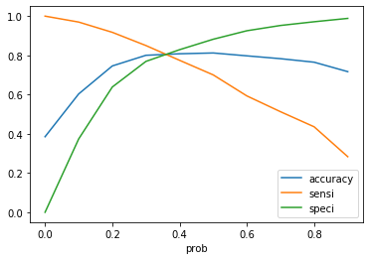
Creating Predicted values in Train set & ROC curve.
Creating a dataframe with the Converted flag and the predicted probabilities.
Creating new column 'predicted' with 1 if Converted_Prob > 0.5 else 0.
Check for Confusion Metrics and VIF.
Plot accuracy, sensitivity and specificity for various probabilities and find the cut-off(we choose 0.33 as cut-off)
Assign lead score(Converted_prob * 100).

Slide 7
Making Predictions on Test Set
Scale test set and add constant.
Model is already trained in train set, transform the data for test set and get the final predicted value.
For Test set:
overall accuracy- 80.2 %
Sensitivity- 80.78 %
Specificity- 79.8 %

Slide 8
Conclusion:
Marketing team must focus on getting the leads from Lead Add Form so that their chance of conversion is maximum.
Lead Source_Welingak Website and leads with current occupation_Working Professional must be targeted as they contribute the most towards probability of getting the lead converted.
Lead score between 0 and 100 to each of the leads which can be used by the company to target potential leads. Higher the lead score, more are the chances to get converted. So business should focus on leads with high Lead Score.

